Slide 1
K-MEDOID ALGORITHM
Presented by:Er.Sudan Prajapati

Slide 2
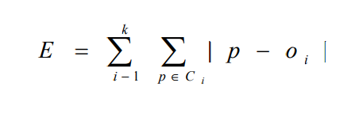
Introduction
Minimize the sensitivity of k-means to outliers
Also known as the Partitioning Around Medoids (PAM) algorithm
Pick actual objects to represent clusters instead of mean values Each remaining object is clustered with the representative object (Medoid) to which is the most similar
The algorithm minimizes the sum of the dissimilarities between each object and its corresponding reference point
E: the sum of absolute error for all objects in the data set
P: the data point in the space representing an object
Oi : is the representative object of cluster Ci

Slide 3
Algorithm
Initially select k random points as the medoids from the given n data points of the data set.
Associate each data point to the closest medoid by using any of the most common distance metrics.
For each medoid m, for each non-medoid data point o:
Swap m and o, recompute the cost (sum of distances of points to their medoid)
If the total cost of the configuration increased in the previous step, undo the swap

Slide 4
Example
X1 | 2 | 6
X2 | 3 | 4
X3 | 3 | 8
x4 | 4 | 7
x5 | 6 | 2
X6 | 6 | 4
X7 | 7 | 3
X8 | 7 | 4
X9 | 8 | 5
x10 | 7 | 6

Slide 5
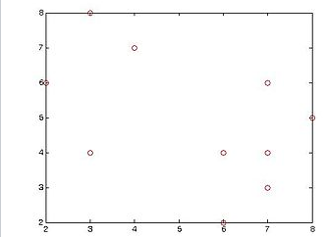

Slide 6
LetCluster the following data set of ten objects into two clusters i.e. k = 2.
Randomly are two observations c1=x2=(3,4)) and c2=x8=(7,4) are selected
For distance let use manhattan distances

Slide 7
Data objects |  | Distance to
i | xi | C1=(3,4) | C2=(7,4)
1 | (2,6) | 3 | 7
2 | (3,4) | 0 | 4
3 | (3,8) | 4 | 8
4 | (4,7) | 4 | 6
5 | (6,2) | 5 | 3
6 | (6,4) | 3 | 1
7 | (7,3) | 5 | 1
8 | (7,4) | 4 | 0
9 | (8,5) | 6 | 2
10 | (7,6) | 6 | 2

Slide 8
Since the points (2,6) (3,8) and (4,7) are closer to c₁ hence they form one cluster whilst remaining points form another cluster. Therefore the clusters become:
Cluster1 = {(3,4)(2,6)(3,8)(4,7)}
Cluster2 = {(7,4)(6,2)(6,4)(7,3)(8,5)(7,6)}

Slide 9
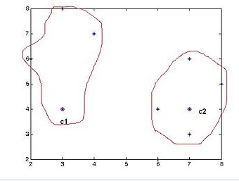

Slide 10
The total cost of this clustering is the sum of the distance between a data point and its cluster center:
3+0+4+4 + 3+1+2+0+2+2=20

Slide 11
Step 2
Select one of the nonmedoids O′
Let us assume O′ = (7,3), i.e. x₇.
So now the medoids are c₁(3,4) and O′(7,3)

Slide 12
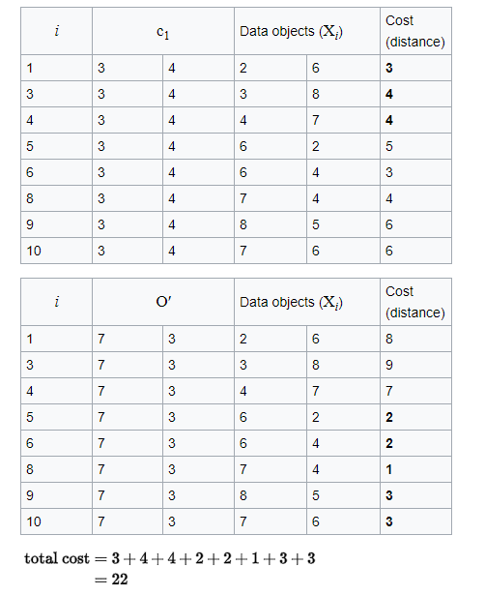

Slide 13
So cost of swapping medoid from c₂ to O′ is
S=current total cost –past total cost
22-20
2 >0
So moving to O′ would be a bad idea, so the previous choice was good.
So we try other nonmedoids and found that our first choice was the best.
So the configuration does not change and algorithm terminates her

Slide 14
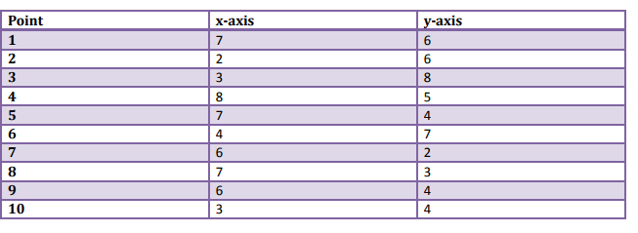
task
Given k=2

